Slide 1
TEAM 3
Flasher,
Low Beam,
Position Lights
By Pavel Cristina, Petrut Cristian Catalin, Tirsina Nicoleta

Slide 2
Table of contents
01.
02.
The project
Requirements
03.
04.
Body Control Module
Automatic Testbench

Slide 3
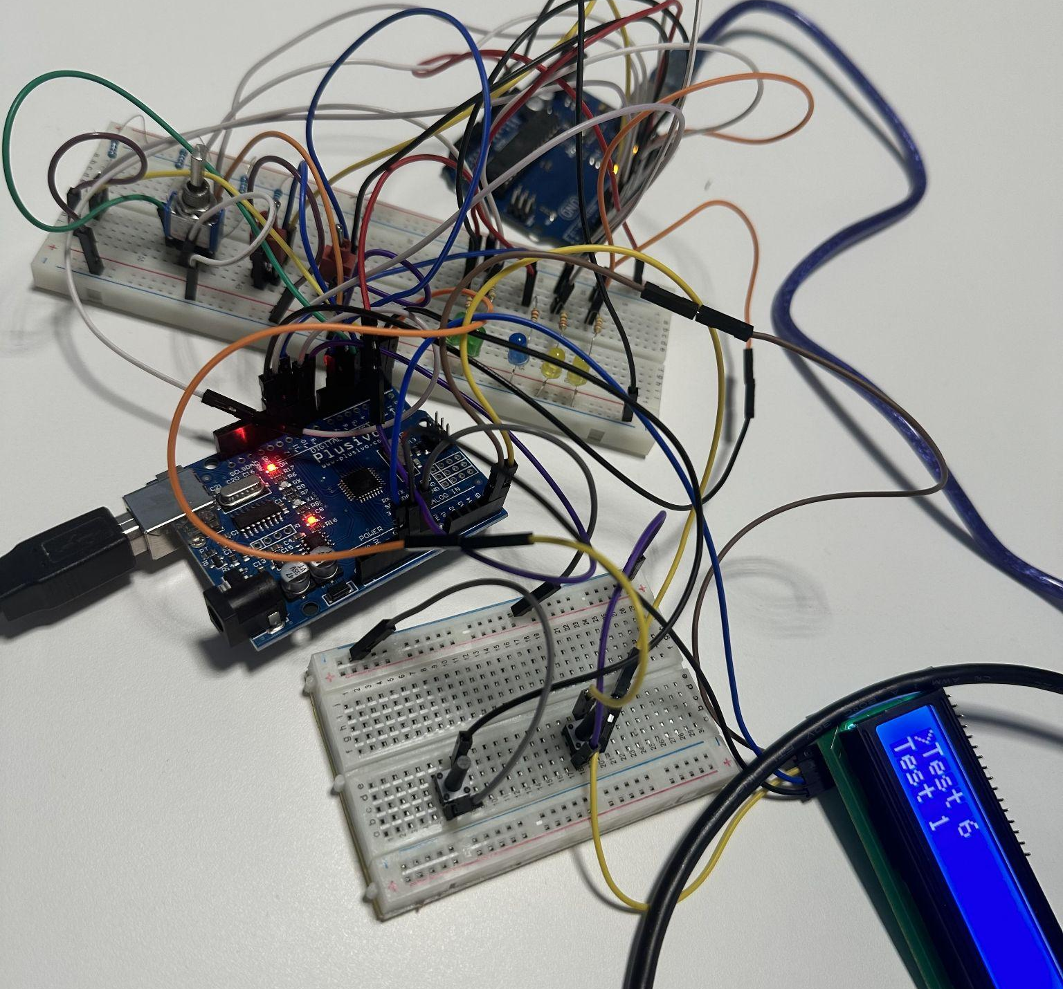
01.
Project Overview

Slide 4

Objective
The objective of our project was to develop and test a control system for car lights (low beams, flasher, and position lights) using the Arduino platform.
The project involves several stages, from initial requirements identification to automated system testing.

Slide 5
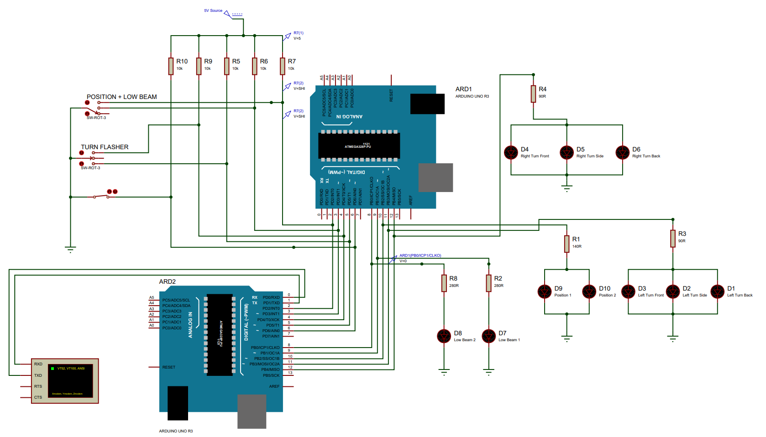

Slide 6
02.
Project Requirements

Slide 7
Requirement Overview
3. Turn Flasher Conditions:
3.1.1 Left flasher: Ignition ON and Left Flasher switch ON.
3.1.2 Right flasher: Ignition ON and Right Flasher switch ON.
3.2 If input active > 3 cycles, flasher ON with 800ms period (400ms dark phase).
3.3 If input active < 3 cycles, flashes 3 times (800ms period, 400ms dark phase).
3.4.1 Switching from left to right terminates left cycle and activates right.
3.4.2 Switching from right to left terminates right cycle and activates left.
3.5 Ignition OFF terminates flashing cycles.
3.6 Flashers turn on within 100ms
1. Low Beam Conditions:
1.1 Ignition switch ON, then Low Beam switch ON.
1.2 Low Beam switch ON, then Ignition switch ON.
1.3 Must activate within 500 ms of meeting conditions.
2. Position Lights Conditions:
2.1 Low Beam or Position Light switch ON.
2.2 Must activate within 500 ms of meeting conditions.

Slide 8
03.
Body Control Module

Slide 9
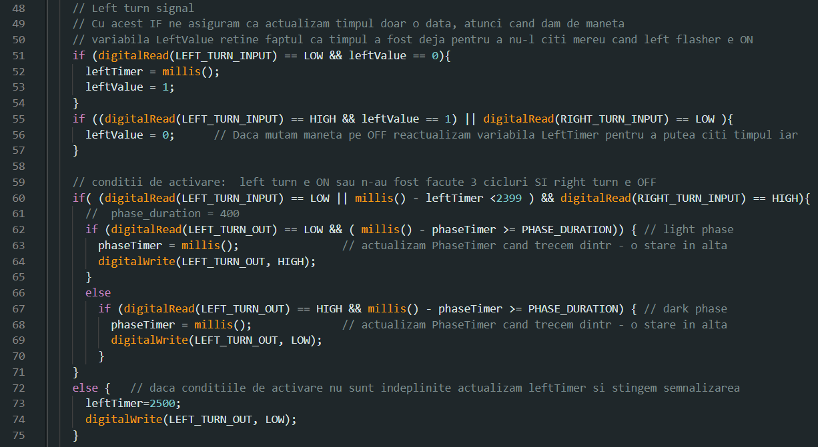

Slide 10
04.
Automatic Testbench

Slide 11
Our Tests
Test 1
Test 2
Test 3
Test 4
Test 5
Position Lights ON within 500 ms
Left Flasher only does 3 cycles when ON for < 2.4s
Low Beams ON within 500 ms
Stress Test for switching from left to right flashing
Left Flasher ON within 100 ms

Slide 12
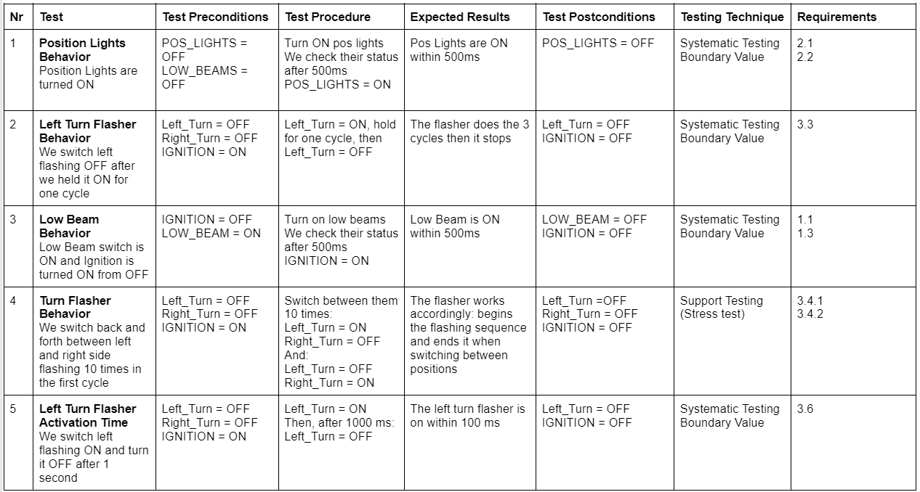

Slide 13
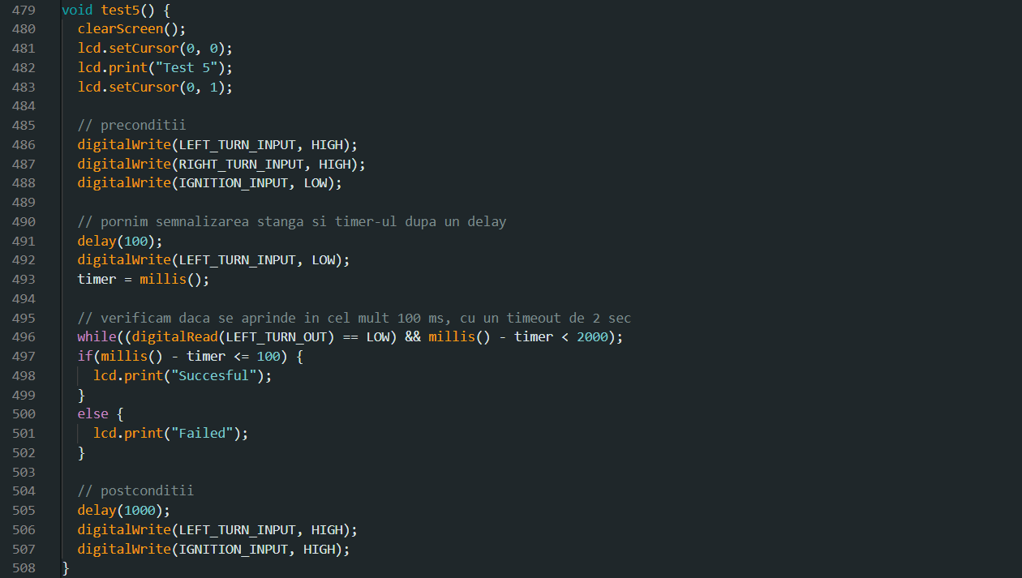

Slide 14
Thank you!

